Slide 1


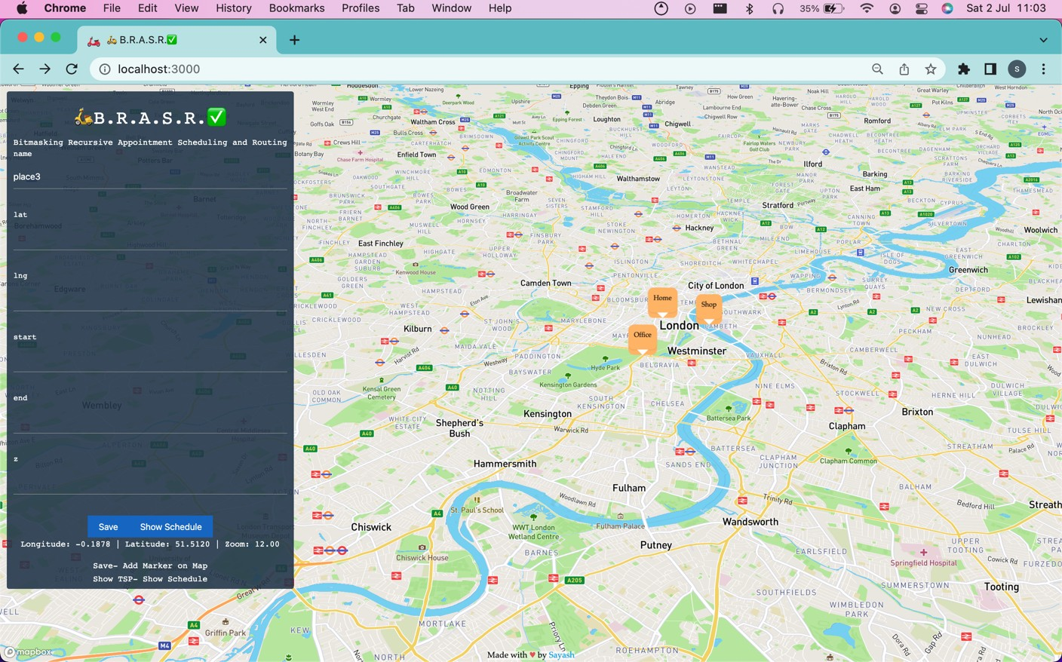
TEAM SAYASH- SAYASH RAAJ, I IT M ADRAS 3 ^{RD} YEAR
🛵B. R. A. S. R. ✅
Bitmasking Recursive Appointment Scheduling and Routing
DOCUMENTATION
Deliverables
Working
Outlook, Teams, Google Calendar, etc. all calendars integration details
Example JSON Request and JSON Response
API model
API scheduling
API Calendar (Outlook, Google Calendar, etc. all calendars) integration
UI integration
Maps integration
UI Calendar (Outlook, Google Calendar, etc. all calendars) integration
Pseudocode for 🛵B.R.A.S.R.✅ algorithm

Slide 2
EXL Hackathon- building solutions for larger challenges faced by insurance companies; solutions that fulfill the needs of consumers; solutions that improve customer experience
Theme- Create a solution for Appointment Scheduling and Routing
Appointment scheduling and routing solution helps in reducing manual, time-taking processes such as maintaining data. security, etc.
This solution helps in tracking locations and addresses. It has been integrated successfully with online maps to improve efficiency, which is not possible in a manual offline process.
Minimum task DONE ✅
Build a restful API to schedule and confirm appointments based on the description mentioned DONE ✅
An interface to clearly see the agenda/calendar for the day with the drive time between appointments DONE ✅
Integration with Outlook/Teams calendar DONE ✅
Intermediate task DONE ✅
Create a smart solution rearranging the appointments to reduce drive time DONE✅
Advanced task DONE ✅
Integration with Teams or Outlook to reflect the agenda DONE ✅
EXTRA CREATIVE task DONE ✅
Can be integrated with ANY calendar (Outlook, Teams, Google, Yahoo, Apple, etc)
Average appointment time can be customised for ALL locations individually
Stateless deAuth approach for null security, privacy-first approach
Tech Stack
REST API
Frontend Framework
Custom-built scheduling and routing algorithm
Uses a 32-bit Bitmasking Recursive approach using an NP-hard solution framework
Recursively finds the shortest path w.r.t time with given constraints
Uses graph-algorithmic approach
Uses bitmasking to store mid-execution state of algorithm
Outlook, Teams, and all calendars integration
ICS-based approach- Has business-centric efficient approach
An out of the box solution, using ICS files has many advantages in this integration activity
Stateless management of activities. Auth integration not required, anonymous user calendar generation
Secure with null privacy concerns as opposed to sharing auth details/token to integrate calendar
Shareable calendar, can be shared inside and outside office team, including vendors, friends, clients, potential clients, etc
ICS file is generated and downloaded automatically in the UI based approach
Using GET request on server url http://localhost:5000/calendar for API approach

Slide 3
🛵B.R.A.S.R.✅ How it works-
Is the best and most efficient way of solving the problem.
Using custom-built modifications on the age-old original Travelling Salesman Problem (TSP), which is considerably the most famous NP-hard problem, we have built the 🛵B.R.A.S.R.✅ algorithm
Solution Flow
User enters locations to visit, entering information in a simple form- clicks Save button Form response is appended to a global array consisting of locations added so far
User clicks Show Schedule button, global array is sent as a JSON array of objects as body request to the Cross-Platform server
[
{
"id": "place0", "coords": {
"lat": 51.51198245486377,
"lng": -0.1278277598563
},
"start": 0,
"end": 1000,
"z": 0
},
{
"id": "place1", "coords": {
"lat": 51.503120589264064,
"lng": -0.15282095066100
},
"start": 0,
"end": 1000,
"z": 0
},
{
"id": "place2", "coords": {
"lat": 51.503341807681544,
"lng": -0.11952824596429
},
"start": 0,
"end": 1000,
"z": 0
}
]
actual request.body sent to server

Slide 4
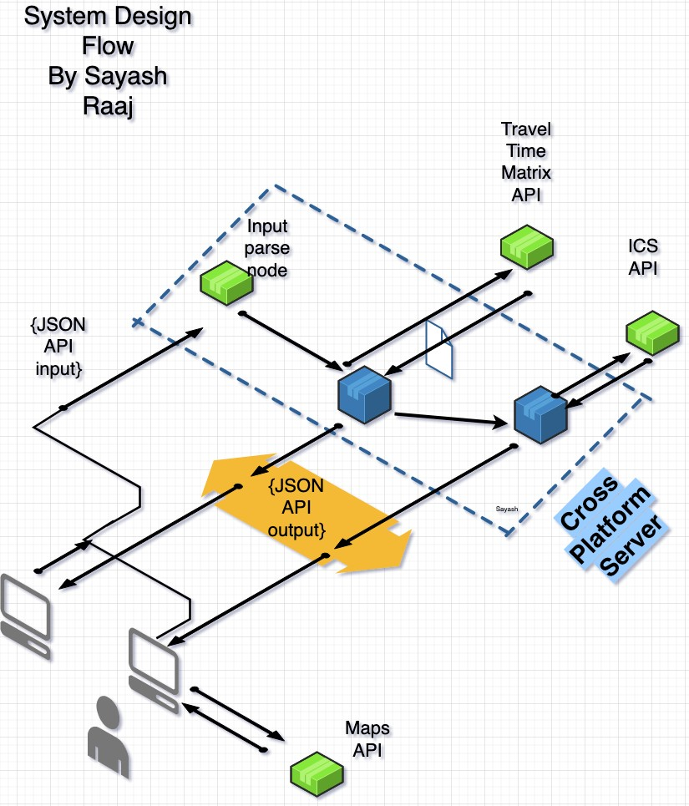
The Cross-Platform Modular Server parses the JSON array in the input parsing node
Server send an internal request to perform the calculative task using the 🛵B.R.A.S.R.✅ algorithm
Calculative function sends an external POST request to Time Travel Matrix API, obtaining information on least distance and time between each node
Parses external API response into an n x n matrix, n = number of nodes
Constructs a dense network as opposed to a sparse network of nodes
Number of edges = nC2 = n(n-1)/2 nodes
🛵B.R.A.S.R.✅ algorithm runs on constructed dense network, returns object
Server reformats output as a union of request.body parameters and 🛵B.R.A.S.R.✅ output JSON output
Server sends an internal request to ICS generating function
External POST request sent, response obtained with necessary ICS configuration
ICS calendar file generated
Server reformats output for ICS file obtained
ICS files can be imported, shared via email etc, and integrated with any modern calendar, including but not limited to Outlook, Teams, Google Calendar, Apple Calendar, Yahoo Calendar, etc.

Slide 5
API Scheduling JSON Response
{
"ans": 3108,
"vec": [
{
"day": 0,
"name": "place0",
"start": "2022-07-02T13:18:09.862Z",
"end": "2022-07-02T13:18:09.862Z"
},
{
"day": 0,
"name": "place1",
"start": "2022-07-02T13:32:50.862Z",
"end": "2022-07-02T13:32:50.862Z"
},
{
"day": 1,
"name": "place0",
"start": "2022-07-03T13:18:09.862Z",
"end": "2022-07-03T13:18:09.862Z"
},
{
"day": 1,
"name": "place2",
"start": "2022-07-03T13:29:22.862Z",
"end": "2022-07-03T13:29:22.862Z"
}
]
}

Slide 6
API Calendar JSON Response
BEGIN:VCALENDAR VERSION:2.0
PRODID:-//sebbo.net//ical-generator//EN BEGIN:VEVENT
UID:d6b5eaf0-fb34-4994-8260-8486a2076c4a
SEQUENCE:0 DTSTAMP:20220702T172419Z
DTSTART:20220702T163217Z DTEND:20220702T163217Z SUMMARY:
LOCATION:Home
END:VEVENT BEGIN:VEVENT
UID:68a6dfd7-6201-40d1-8262-5c0c2fc94445 SEQUENCE:0
DTSTAMP:20220702T172419Z DTSTART:20220702T164658Z DTEND:20220702T164658Z SUMMARY:
LOCATION:Office END:VEVENT BEGIN:VEVENT
UID:fbcaafd2-4692-4d90-83ef-aabf99b909f1 SEQUENCE:0
DTSTAMP:20220702T172419Z
DTSTART:20220703T163217Z DTEND:20220703T163217Z
SUMMARY:
LOCATION:Home END:VEVENT BEGIN:VEVENT
UID:26228bb1-4b4a-4422-ae1d-a2e300f01412 SEQUENCE:0
DTSTAMP:20220702T172419Z DTSTART:20220703T164330Z
DTEND:20220703T164330Z SUMMARY:
LOCATION:Shop END:VEVENT
BEGIN:VEVENT
UID:fed62d25-7f47-46f2-bd4c-4a70b1ae2819 SEQUENCE:0
DTSTAMP:20220702T172419Z
DTSTART:20220704T163217Z DTEND:20220704T163217Z SUMMARY:
LOCATION:Home END:VEVENT

Slide 7
BEGIN:VEVENT
UID:a54a8a43-09fb-4a77-bc39-775756c5909b SEQUENCE:0
DTSTAMP:20220702T172419Z DTSTART:20220704T164109Z DTEND:20220704T164249Z SUMMARY:
LOCATION:place3 END:VEVENT END:VCALENDAR

Slide 8

Maps integration
Maps integration displays all locations input by user
Home node is genesis node, first location input by user No limit on number of nodes or locations

Slide 9
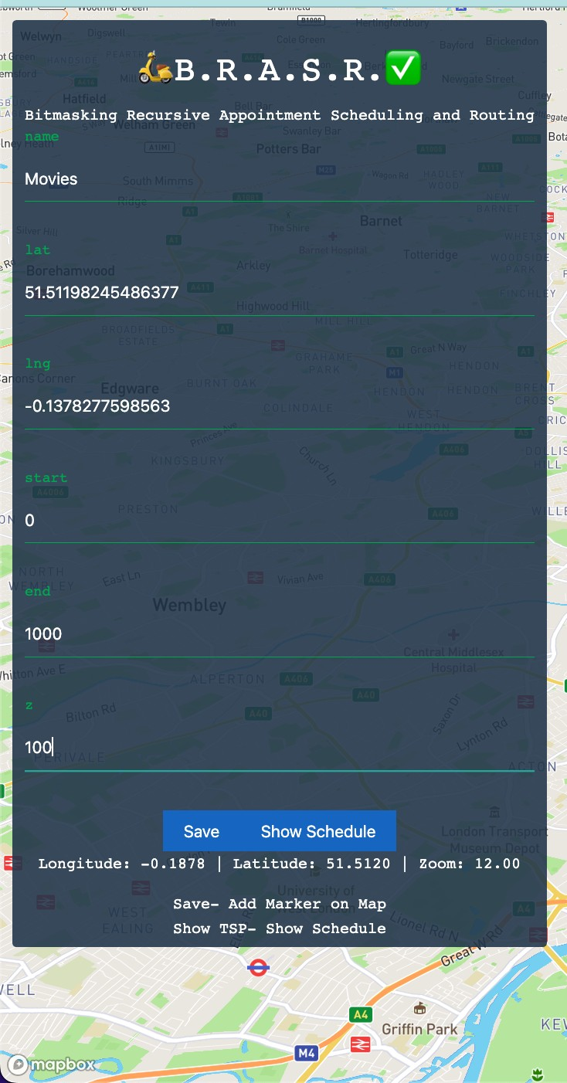
Input form- appending locations input by user- node creation at instant

Slide 10

New node created and displayed, dynamic real-time Maps integration

Slide 11
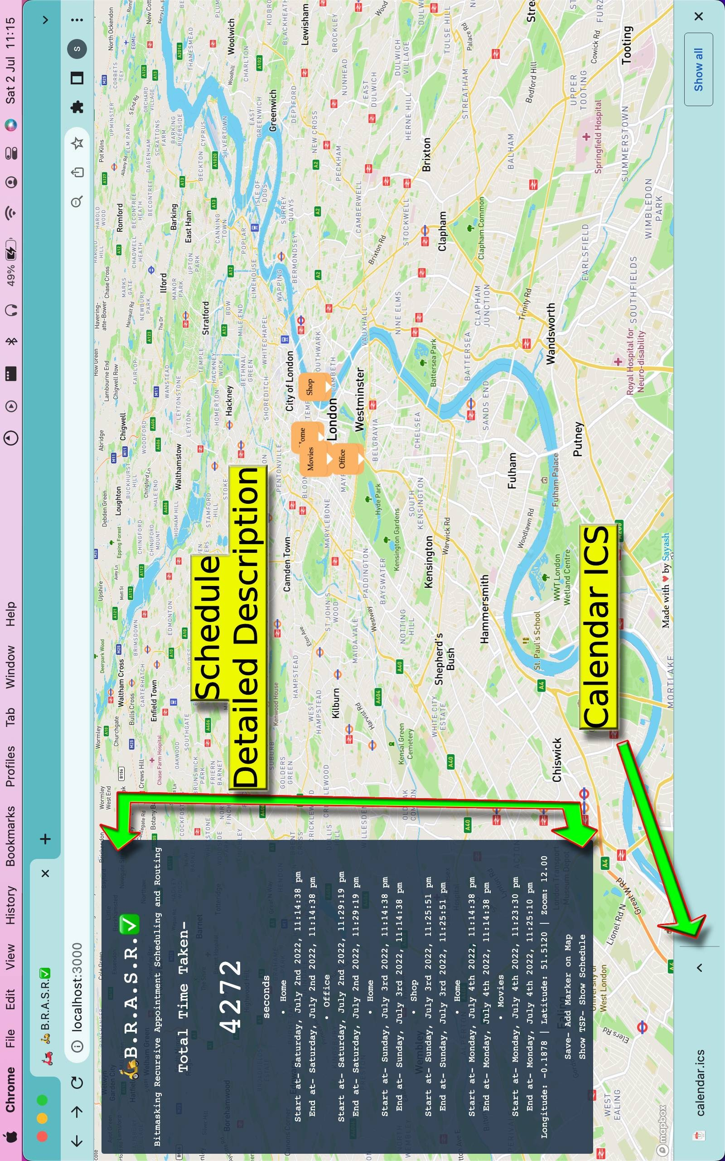

Slide 12
Pseudocode for 🛵B.R.A.S.R.✅ algorithm
vis_mask = 32-bit mask state storage of all visited nodes skipped_mask = 32-bit mask state storage of all skipped nodes pos = node number mapped to location
ssf = current time so far
total = total time so far day = current day
int BRASR(int vis_mask, int skipped_mask, int pos, int ssf, int total, int day)
if(vis_mask == all nodes visited)
if(skipped_mask == no nodes were skipped) // termination condition return total time +(time from pos -> home)
else
vis_mask = all nodes visited and not skipped mark home node as visited
return BRASR(…, pos=0, ssf=0, total time)
for( i=0; i<number of nodes; i++) if (node i is not visited)
mark node i as visited
if(current time + avg time for aptmnt. z_{i} > end time for aptmnt.) cant be completed today, mark as skipped for today
else
update current time to expected time at end of appointment ans = min(ans, BRASR(…, ssf=exp. end time))
if(all nodes visited in loop) if(no nodes skipped)
return ans
vis_mask = all nodes visited and not skipped increment day by 1, marking for next day
ans = BRASR(…,pos=0, ssf=0, total time, day+1)
int main()
return BRASR(1,0,0,0,0,0);

